Slide 1

Atliq Hardware: Consumer Goods Ad Hoc Analytics
Empowering Data-Driven Decisions in a Global Marketplace

Slide 2
Agenda
1
Introduction to Atliq Hardware
2
Company Overview & Structure
3
Business Model Explained
4
Addressing the Data Insight Gap
5
Ad-Hoc Reporting Analysis

Slide 3
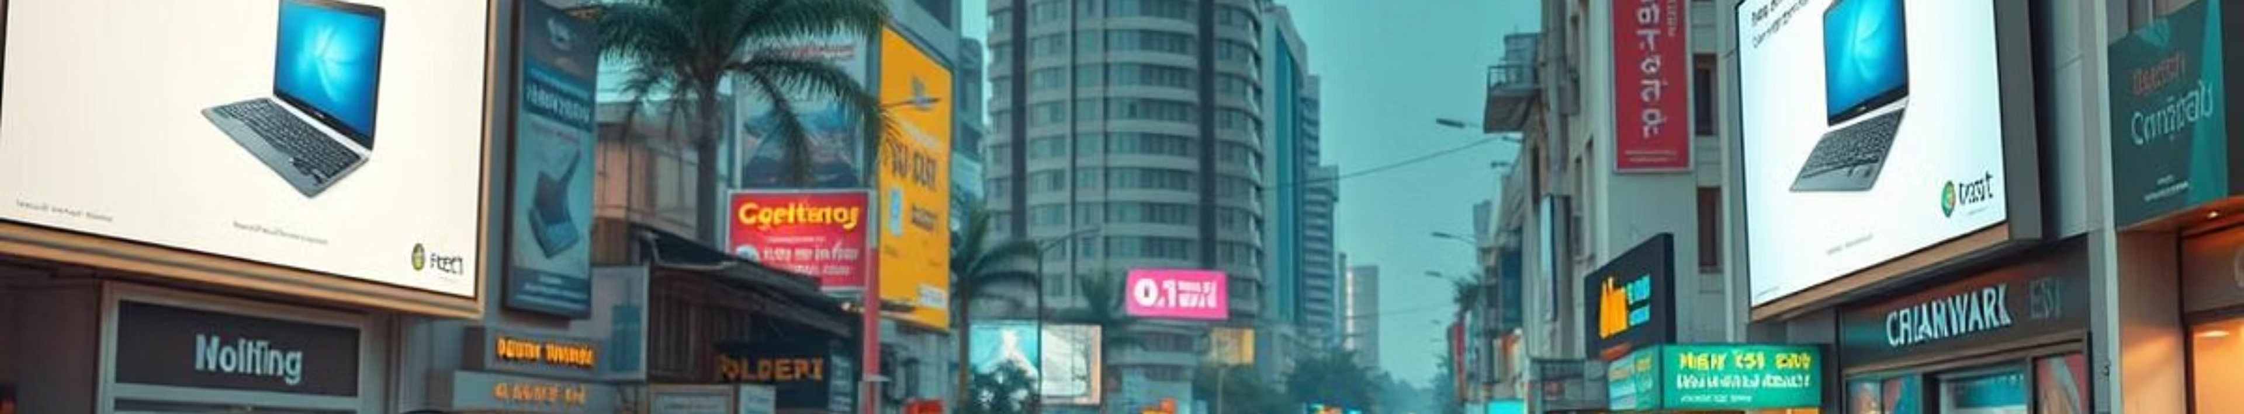
What is Atliq Hardware?
Atliq Hardware is a leading computer hardware producer, originating from India and maintaining a strong international presence. Our commitment to innovation and quality has positioned us at the forefront of the consumer electronics market.

Slide 4
Atliq Hardware: Operational Structure
Atliq's fiscal year runs from September to August.
Atliq categorize hardware offerings into three primary divisions to better serve diverse market needs:
1
2
3
Division: PC
Division: N&S (Networking & Storage)
Division: P&A (Peripherals & Accessories)
Segment: Desktop (Personal, Gaming)
Segment: Storage (USB Flashdrives)
Segment: Peripherals (Graphic Cards, Motherboards, Processors)
Segment: Notebook (Business, Gaming)
Segment: Networking (Wi-Fi Extenders)
Segment: Accessories (Internal HDDs, Batteries, Keyboards, Mouse)

Slide 5

Atliq Hardware: Business Model
Atliq Hardware operates on an omnichannel business model, leveraging both direct and indirect sales channels to maximize customer reach.
We partner with various retailers, including traditional stores and e-commerce platforms, and work with distributors to expand our market presence. Concurrently, we are developing our own direct-to-consumer channels, such as our dedicated e-commerce website.
This dual approach ensures broad market coverage and allows customers to purchase Atliq Hardware products through their preferred method, adapting to diverse market needs.
Notes:
Our business model combines a direct-to-consumer approach with an extensive network of indirect sales channels. The direct-to-consumer channel is anchored by our dedicated e-commerce website, which offers a seamless online shopping experience for our full product range. Complementing this, we also partner with a wide network of traditional brick-and-mortar retailers, diverse e-commerce platforms, and established distributors to maximize our market reach through indirect channels. This omnichannel strategy allows us to serve customers through their preferred purchasing methods, whether that's directly through our e-store or via our network of retail and distribution partners. The combination of direct and indirect channels gives us broad market coverage and flexibility to meet evolving customer preferences.

Slide 6
The Problem: Bridging the Insight Gap
"We currently lack the comprehensive, real-time insights needed to make agile, data-informed decisions."
To address this challenge, Tony Sharma, Director of Data Analytics, is expanding the team with junior data analysts. The selection process will involve a SQL challenge designed to assess both technical proficiency and crucial soft skills, ensuring new hires can contribute meaningfully to our strategic goals.

Slide 7

Ad-Hoc Reporting Analysis
To bridge our insight gap, Atliq Hardware needed immediate answers to 10 critical business questions.
These inquiries required us to generate targeted, ad-hoc reports by directly extracting and analyzing data using SQL queries.

Slide 8
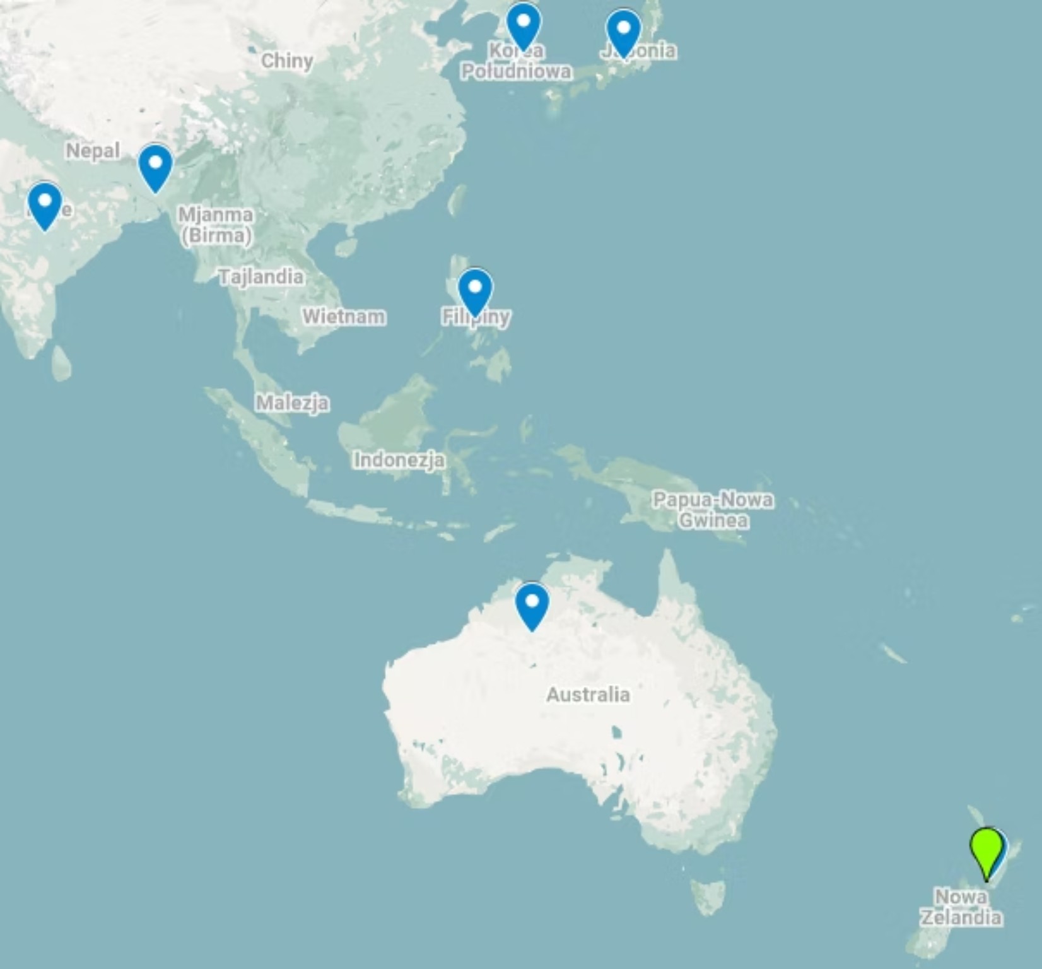
1. For what countries in APAC Region Atliq Exclusive runs a business
Atliq Exclusive is the e-store of Atliq Hardware.

Slide 9
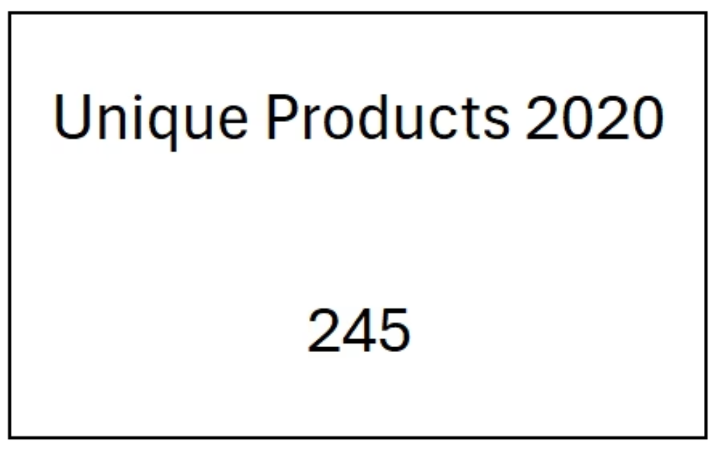
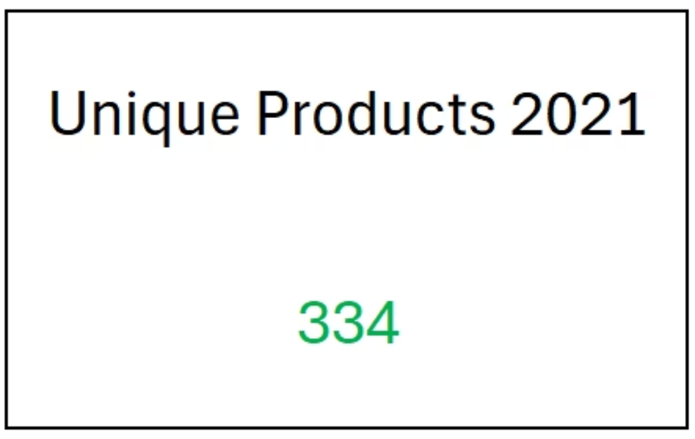
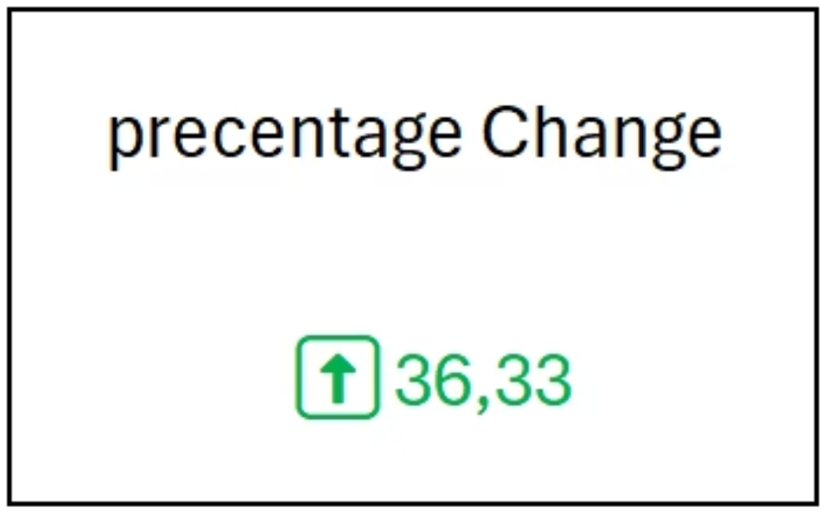
2. What is percentage of unique product increase in 2021 vs 2020.
in 2020 company had 245 unique products
In 2021, the company had 334 unique products, which is a significantly better result compared to the previous year
a large and dynamic increase in the number of new products is a positive value, proving the company's development and capturing a larger share of the market

Slide 10
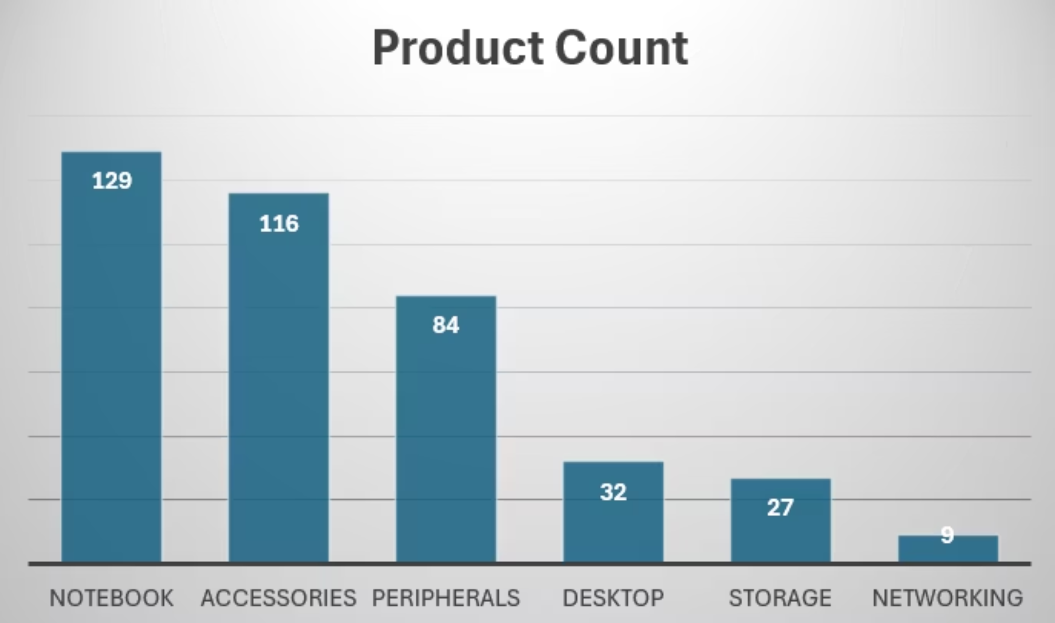
3. Provide a report with all unique product counts for each segment
The bar chart shows the company is strongly developed in three segments: Notebook, Accessories, and Peripherals. On the other hand, the other three segments are underdeveloped, which may suggest they are underperforming.

Slide 11
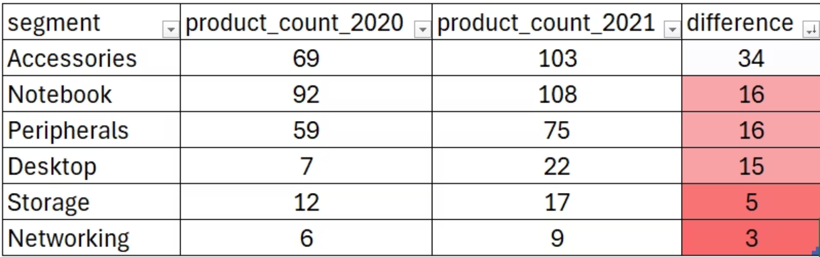
4.Which segment had the most increase in unique products in 2021 vs 2020
The table reinforces the trend from the previous slide: Storage and Networking segments show no growth, potentially risking market position.

Slide 12


5. Products that have highest and lowest manufacturing costs
Product
Product
AQ Master wired x1 Ms
AQ HOME Allin1 Gen 2
Cost $0,89
Cost $240,53

Slide 13
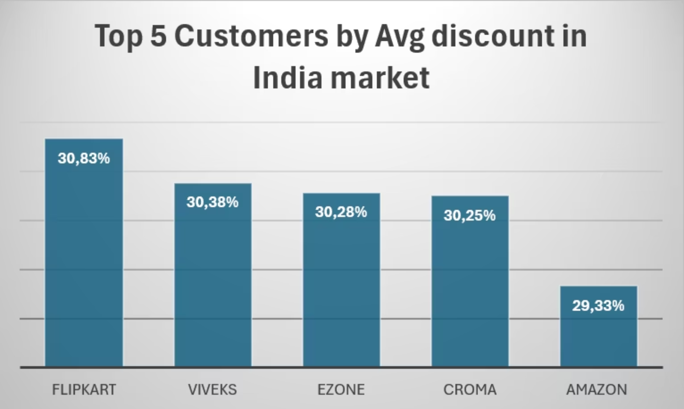
6. Report which contains the top 5 customers who received an average high pre_invoice_discount_pct for the fiscal year 2021 and in the Indian market

Slide 14
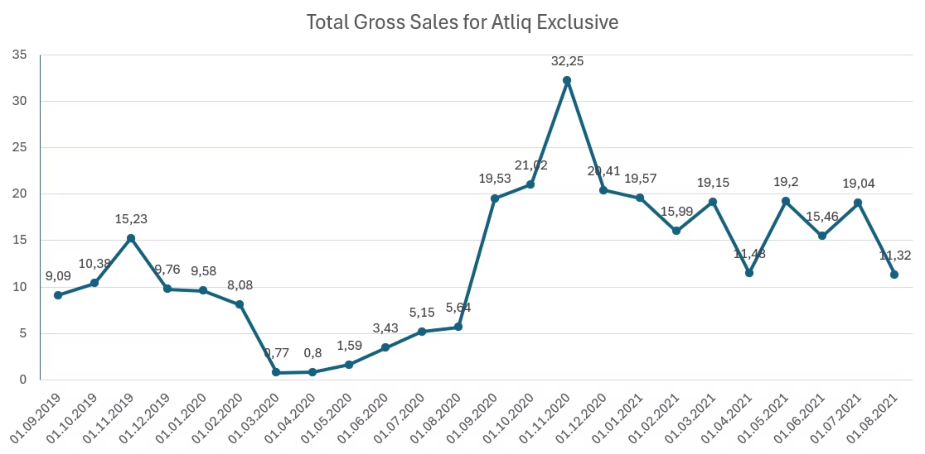
7. Raport of gross sales amount in milion for Atliq Exclusive for each month

Slide 15
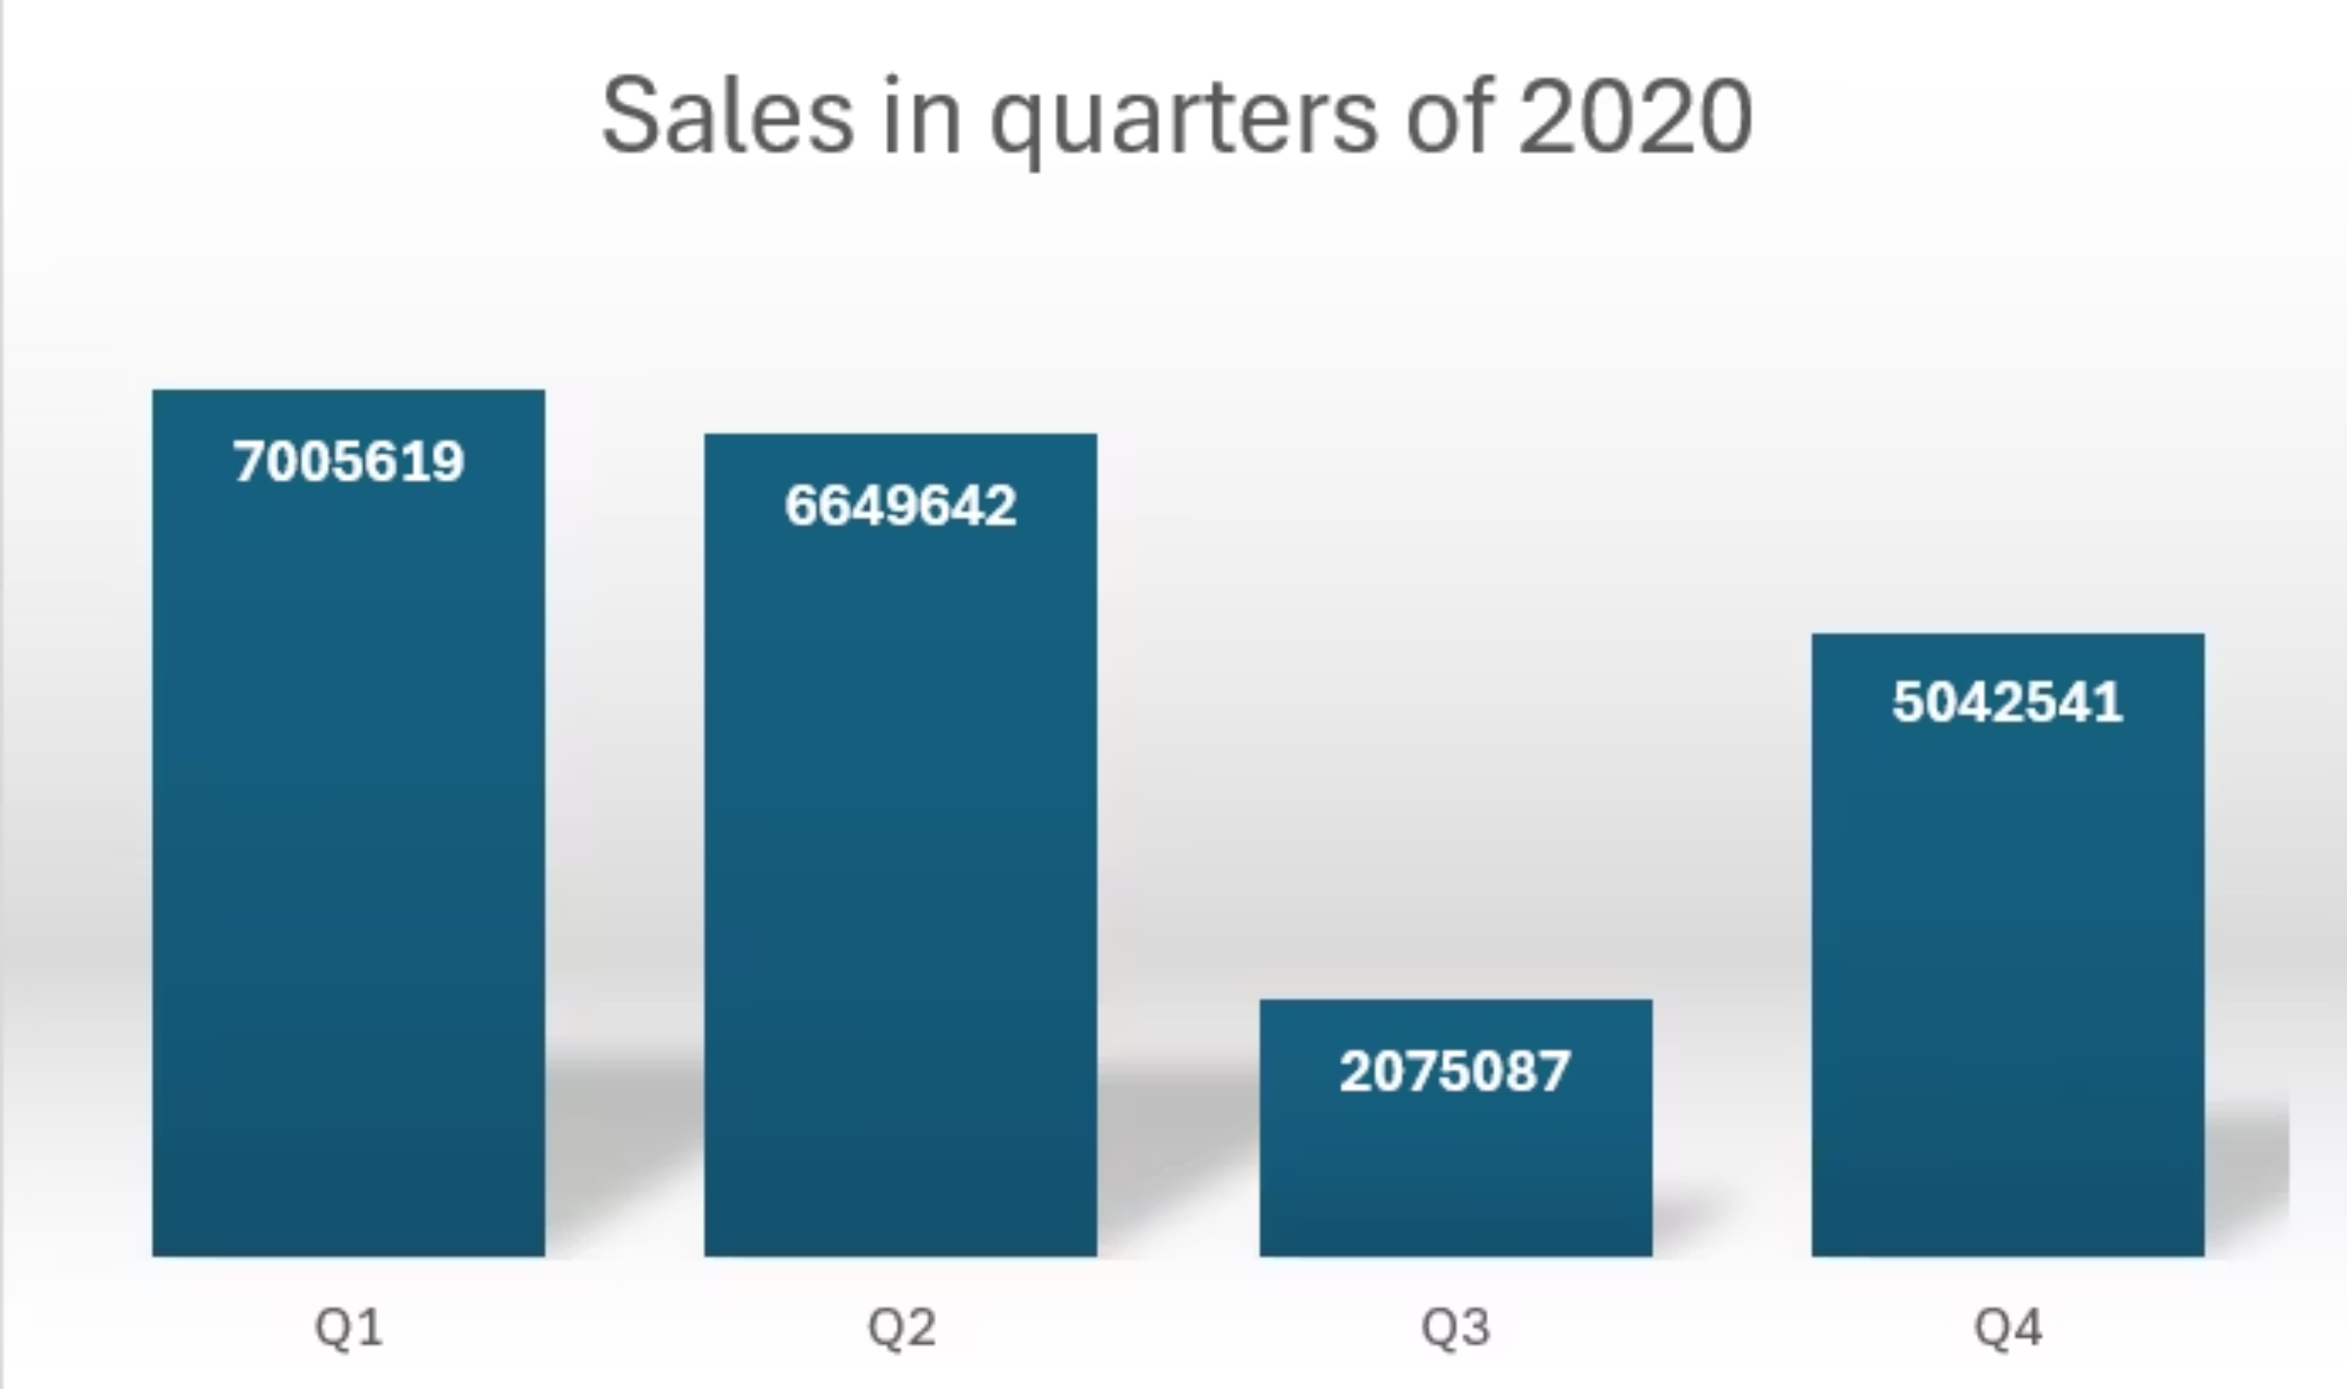
8. Raport of total sold quantity in 2020

Slide 16
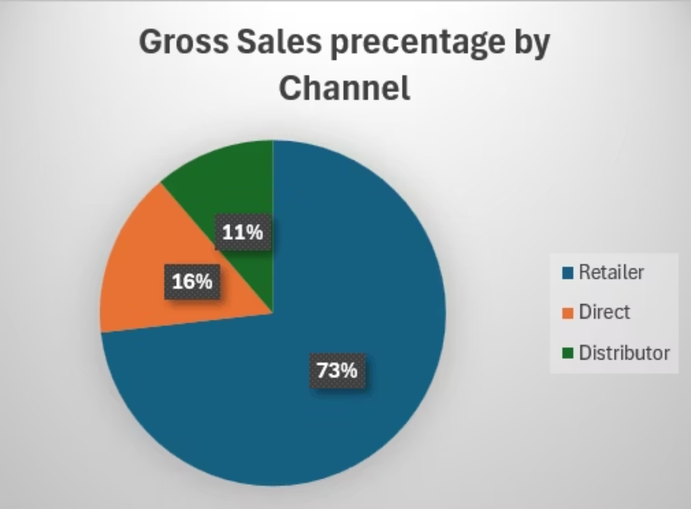
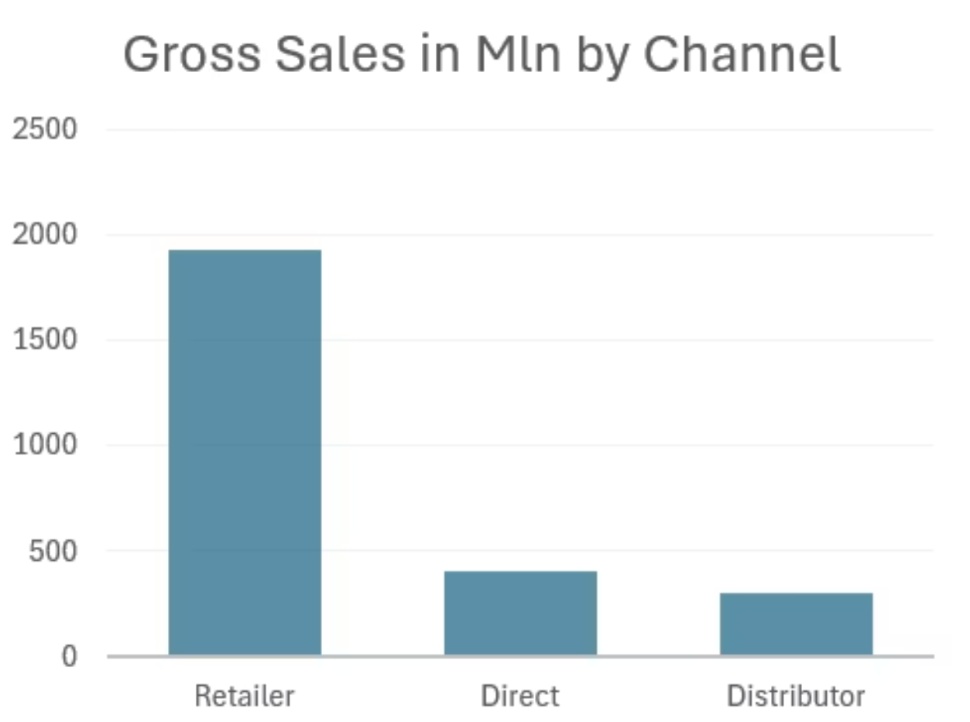
9. Raport of gross sales contribution
Retailers most often contribute to gross sales, which may be an inappropriate value because it leads to an advantage for buyers, which gives buyers a better negotiating position

Slide 17
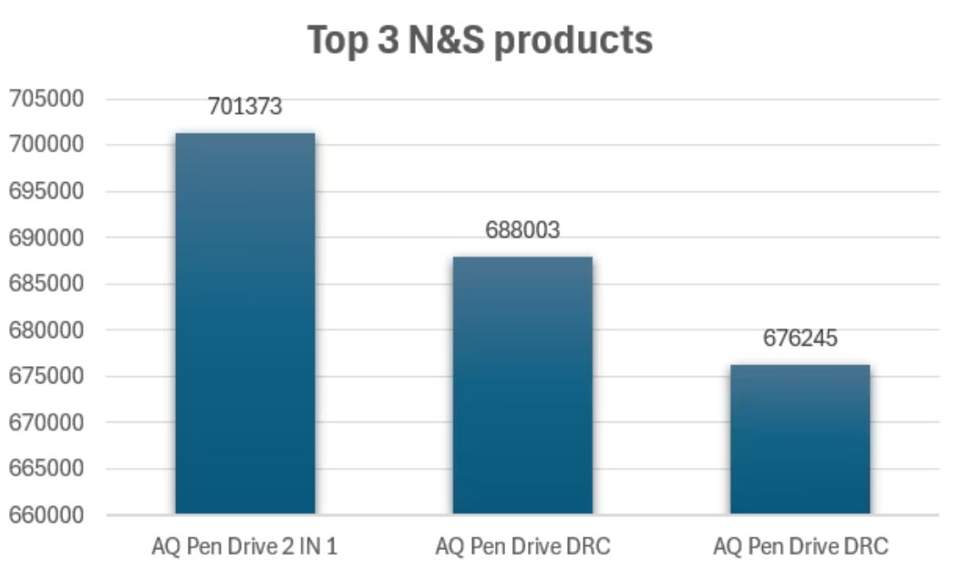
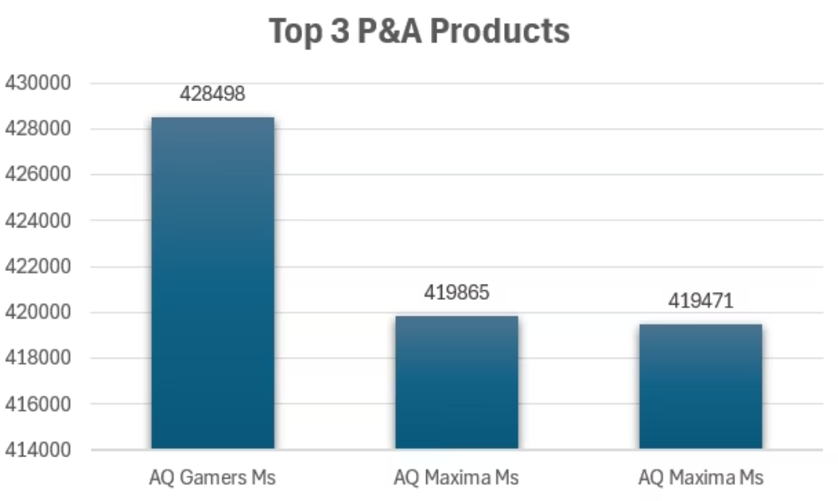
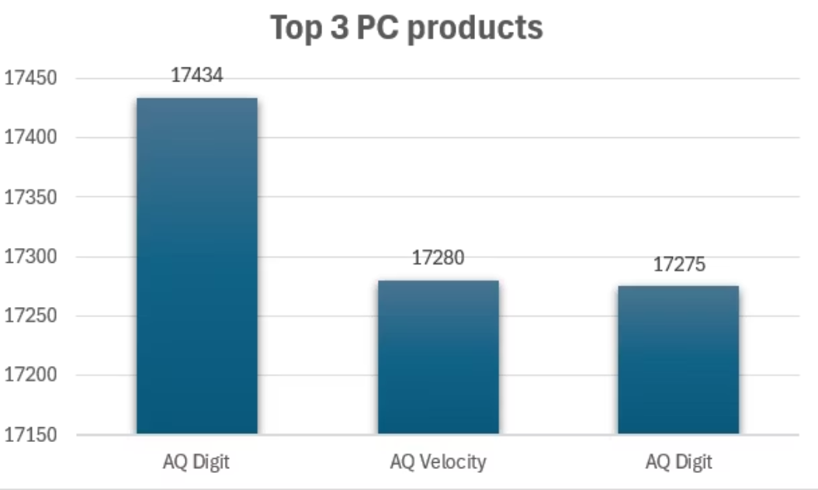
10. Raport of top 3 products of each division

